Slide 1
Question 2
Presented by Jamil Rayhan
ID: 18CSE061

Slide 2
Question
Design of a combinational circuit with a decoder and external gates for the following three Boolean functions:
F₁= x’y’z’+yz
F₂= x’yz’+x’z
F₃=xyz’+z

Slide 3
Given function
F₁ = x’y’z’+yz
F₂ = x’yz’ + x’z
F₃ = xyz’+z

Slide 4
Function F₁
F₁ = x’y’z’+yz
= x’y’z’+(x+x’)yz
= x’y’z’+xyz+x’yz
= ∑(0,3,7)

Slide 5
Function F₂
F₂ = x’yz’ + x’z
= x’yz’ + x’(y+y’)z
= x’yz’ + x’yz+x’y’z
=∑(1,2,3)

Slide 6
Function F₃:-
F₃ = xyz’+z
= xyz’+(x+x’)z
= xyz’+xz+x’z
= xyz’+x(y+y’)z+x’(y+y’)z
= xyz’+xyz+xy’z+x’yz+x’y’z
= ∑(1,3,5,6,7)

Slide 7
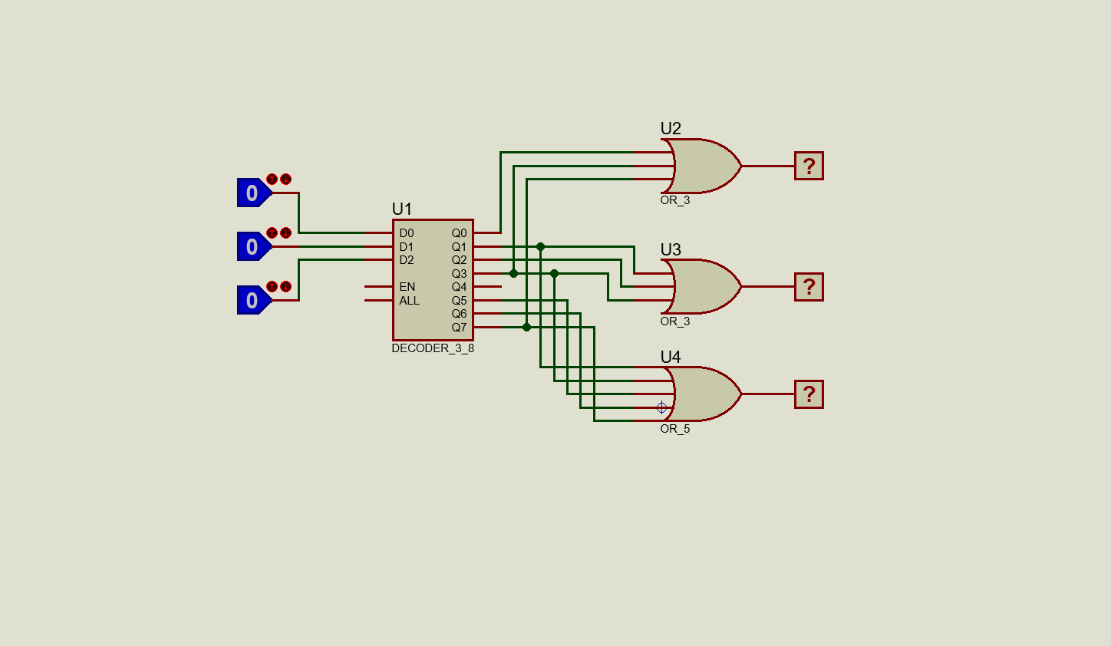
Circuit Diagram
F₁
A
B
C
F₂
F₃

Slide 8
Thank you

